Slide 1
Little Elm
Independent
School
District
1Q22
Demographic Report

Slide 2
Little Elm ISD Historical Home Sales
*2022-YTD sales span January 2022 – March 2022

Slide 3
Little Elm ISD Home Price Analysis
 | Avg New Home Price | Avg Existing Home Price
2010 | $212,786 | $176,616
2011 | $223,697 | $176,861
2012 | $230,162 | $188,829
2013 | $250,144 | $198,542
2014 | $249,733 | $209,295
2015 | $270,065 | $233,333
2016 | $280,461 | $247,495
2017 | $311,187 | $264,084
2018 | $318,982 | $281,136
2019 | $317,617 | $291,001
2020 | $375,316 | $322,802
2021 | $456,559 | $370,827
2022-YTD | $490,901 | $429,420
Since 2010, the average new home price in LEISD has more than doubled, rising over $278,100
The average existing home price within the district has more than doubled since 2010, increasing nearly $253,000

Slide 4
District New Home Starts and Closings
Starts | 2016 | 2017 | 2018 | 2019 | 2020 | 2021 | 2022 |  | Closings | 2016 | 2017 | 2018 | 2019 | 2020 | 2021 | 2022
1Q | 381 | 237 | 330 | 219 | 183 | 158 | 158 |  | 1Q | 256 | 194 | 349 | 213 | 226 | 127 | 146
2Q | 242 | 435 | 319 | 240 | 201 | 158 |  |  | 2Q | 262 | 282 | 366 | 374 | 235 | 176
3Q | 163 | 489 | 391 | 216 | 179 | 221 |  |  | 3Q | 378 | 323 | 283 | 452 | 244 | 144
4Q | 301 | 310 | 336 | 262 | 250 | 228 |  |  | 4Q | 203 | 459 | 422 | 233 | 214 | 139
Total | 1,087 | 1,471 | 1,376 | 937 | 813 | 765 | 158 |  | Total | 1,099 | 1,258 | 1,420 | 1,272 | 919 | 586 | 146

Slide 5
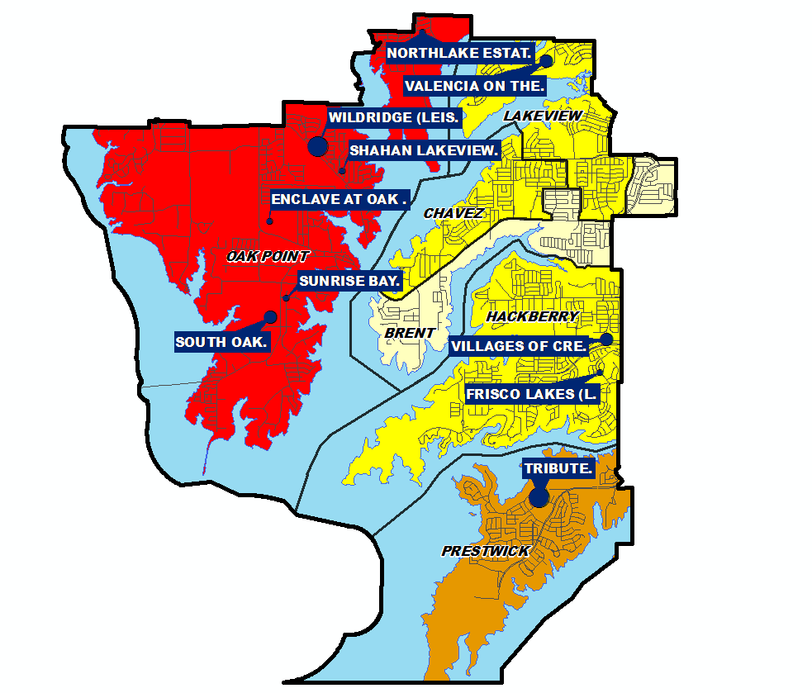
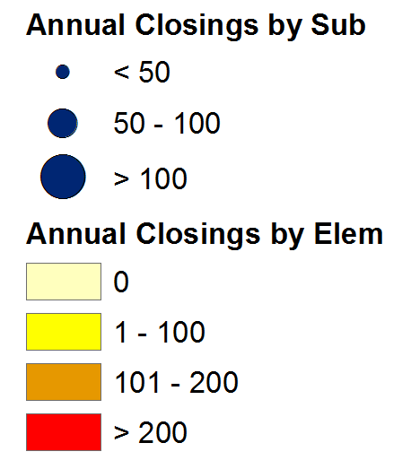
Annual Closing Distribution
Top 10 Subdivisions - (Ranked by Annual Closings)
Rank | Subdivision | Elementary Zone | Annual Closings | Quarter Closings | VDL | Future
1 | WILDRIDGE (LEISD) | OAK POINT | 142 | 29 | 4 | 0
2 | TRIBUTE | PRESTWICK | 128 | 30 | 172 | 258
3 | VALENCIA ON THE LAKE (LEISD) | LAKEVIEW | 84 | 13 | 0 | 455
4 | VILLAGES OF CREEKWOOD | HACKBERRY | 53 | 13 | 5 | 240
5 | SOUTH OAK | OAK POINT | 51 | 10 | 115 | 281
6 | SHAHAN LAKEVIEW ADDITION | OAK POINT | 46 | 0 | 0 | 0
7 | NORTHLAKE ESTATES | OAK POINT | 40 | 33 | 22 | 332
8 | ENCLAVE AT OAK GROVE | OAK POINT | 33 | 10 | 65 | 0
9 | FRISCO LAKES (LEISD) | AGE RESTRICTED | 15 | 0 | 0 | 0
10 | SUNRISE BAY | OAK POINT | 9 | 6 | 27 | 0
 | TOTALS |  | 601 | 144 | 410 | 1,566

Slide 6
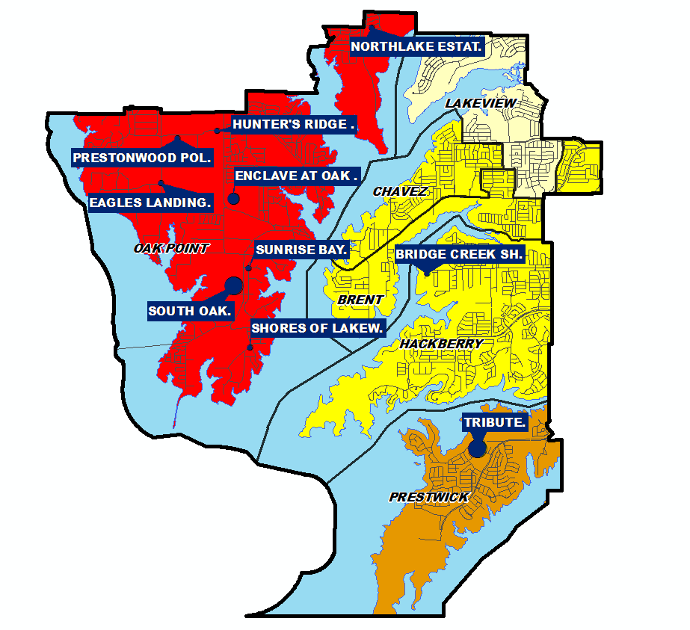
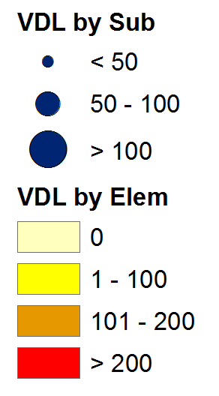
VDL Distribution
Top 10 Subdivisions - (Ranked by remaining VDL)
Rank | Subdivision | Elementary Zone | Annual Closings | Quarter Closings | VDL | Future
1 | TRIBUTE | PRESTWICK | 128 | 30 | 172 | 258
2 | SOUTH OAK | OAK POINT | 51 | 10 | 115 | 281
3 | ENCLAVE AT OAK GROVE | OAK POINT | 33 | 10 | 65 | 0
4 | SUNRISE BAY | OAK POINT | 9 | 6 | 27 | 0
5 | NORTHLAKE ESTATES | OAK POINT | 40 | 33 | 22 | 332
6 | PRESTONWOOD POLO AND COUNTRY CLUB | OAK POINT | 0 | 0 | 22 | 0
7 | HUNTER'S RIDGE ESTATES | OAK POINT | 1 | 0 | 13 | 0
8 | SHORES OF LAKEWOOD VILLAGE | OAK POINT | 3 | 0 | 11 | 0
9 | EAGLES LANDING | OAK POINT | 1 | 0 | 11 | 0
10 | BRIDGE CREEK SHORES ADDN. | HACKBERRY | 0 | 0 | 9 | 0
 | TOTALS |  | 266 | 89 | 467 | 871

Slide 7
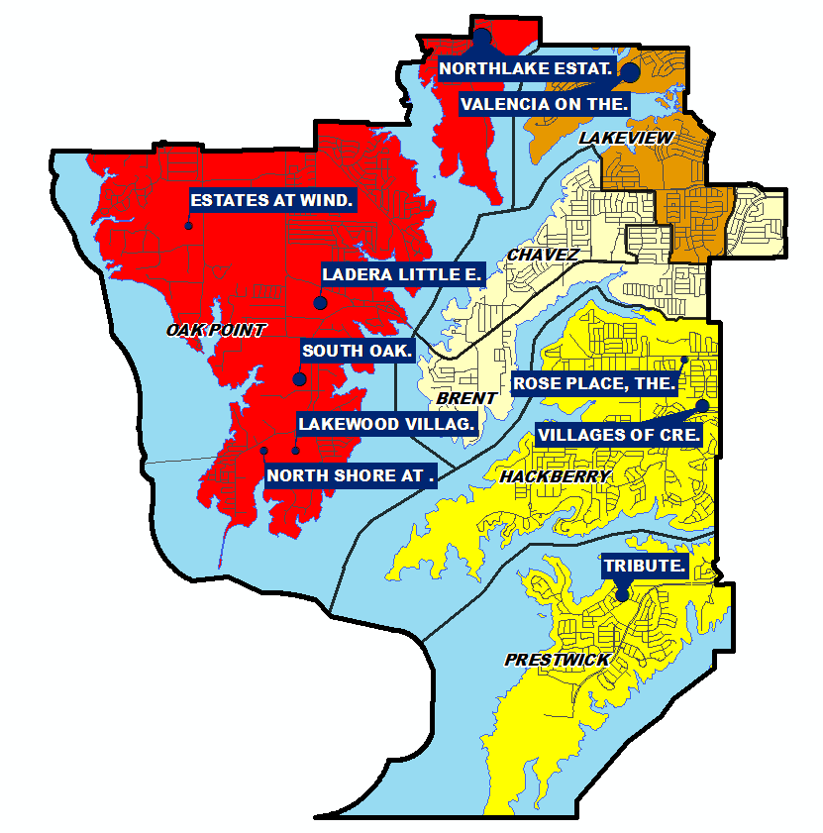
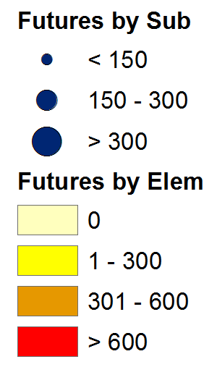
Futures Distribution
Top 10 Subdivisions - (Ranked by Future Inventory)
Rank | Subdivision | Elementary Zone | Annual Closings | Quarter Closings | VDL | Future
1 | VALENCIA ON THE LAKE (LEISD) | LAKEVIEW | 84 | 13 | 0 | 455
2 | NORTHLAKE ESTATES | OAK POINT | 40 | 33 | 22 | 332
3 | SOUTH OAK | OAK POINT | 51 | 10 | 115 | 281
4 | LADERA LITTLE ELM | AGE RESTRICTED | 0 | 0 | 0 | 263
5 | TRIBUTE | PRESTWICK | 128 | 30 | 172 | 258
6 | VILLAGES OF CREEKWOOD | HACKBERRY | 53 | 13 | 5 | 240
7 | LAKEWOOD VILLAGE | OAK POINT | 0 | 0 | 0 | 148
8 | NORTH SHORE AT LAKEWOOD VILLAGE | OAK POINT | 0 | 0 | 0 | 80
9 | ESTATES AT WINDSOR SPRINGS | OAK POINT | 0 | 0 | 0 | 65
10 | ROSE PLACE, THE | HACKBERRY | 0 | 0 | 0 | 34
 | TOTALS |  | 356 | 99 | 314 | 2,156

Slide 8
District Housing Overview by Elementary Zone
Elementary Zone | Annual Starts | Quarter Starts | Annual Closings | Quarter Closings | Under Construction | Inventory | Vacant Dev. Lots | Future Lots
BRENT | 0 | 0 | 0 | 0 | 0 | 0 | 9 | 0
CHAVEZ | 3 | 3 | 1 | 0 | 4 | 4 | 1 | 0
HACKBERRY | 40 | 1 | 53 | 13 | 21 | 25 | 18 | 274
LAKEVIEW | 47 | 0 | 84 | 13 | 15 | 17 | 0 | 455
OAK POINT | 499 | 130 | 339 | 90 | 323 | 396 | 304 | 939
PRESTWICK | 122 | 24 | 128 | 30 | 72 | 76 | 172 | 258
Grand Total | 711 | 158 | 605 | 146 | 435 | 518 | 504 | 1,926
 | Highest activity in the category
 | Second highest activity in the category
 | Third highest activity in the category

Slide 9
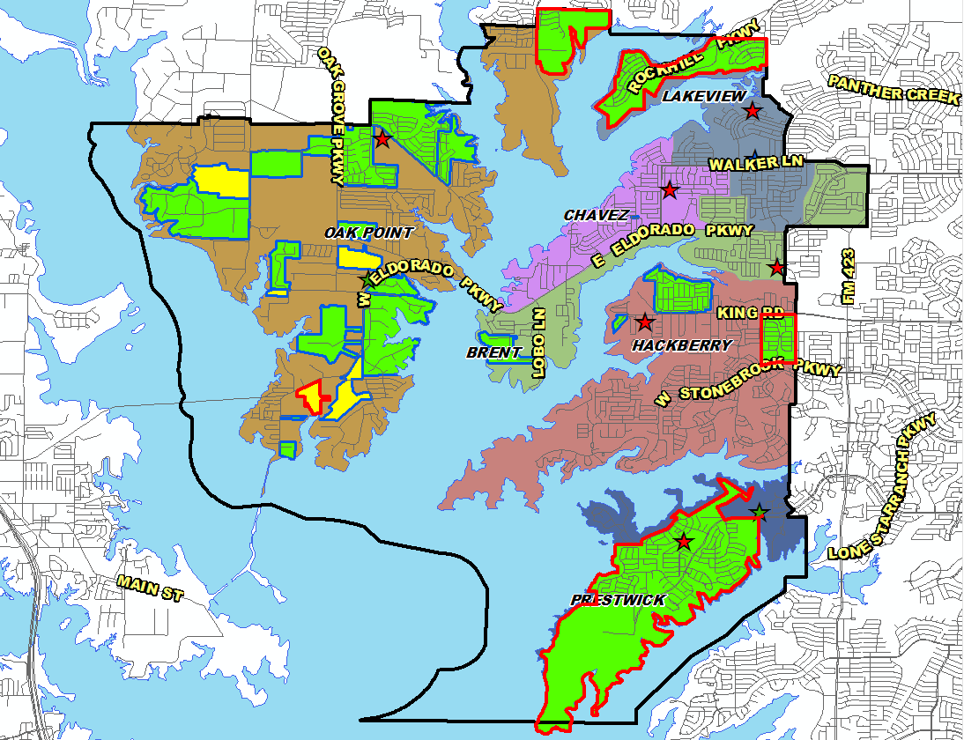
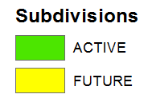
District Housing Overview
The district has 21 actively building subdivisions
Within LEISD there are 6 future subdivisions
Groundwork is underway on roughly 1,160 lots within 5 subdivisions

Slide 10
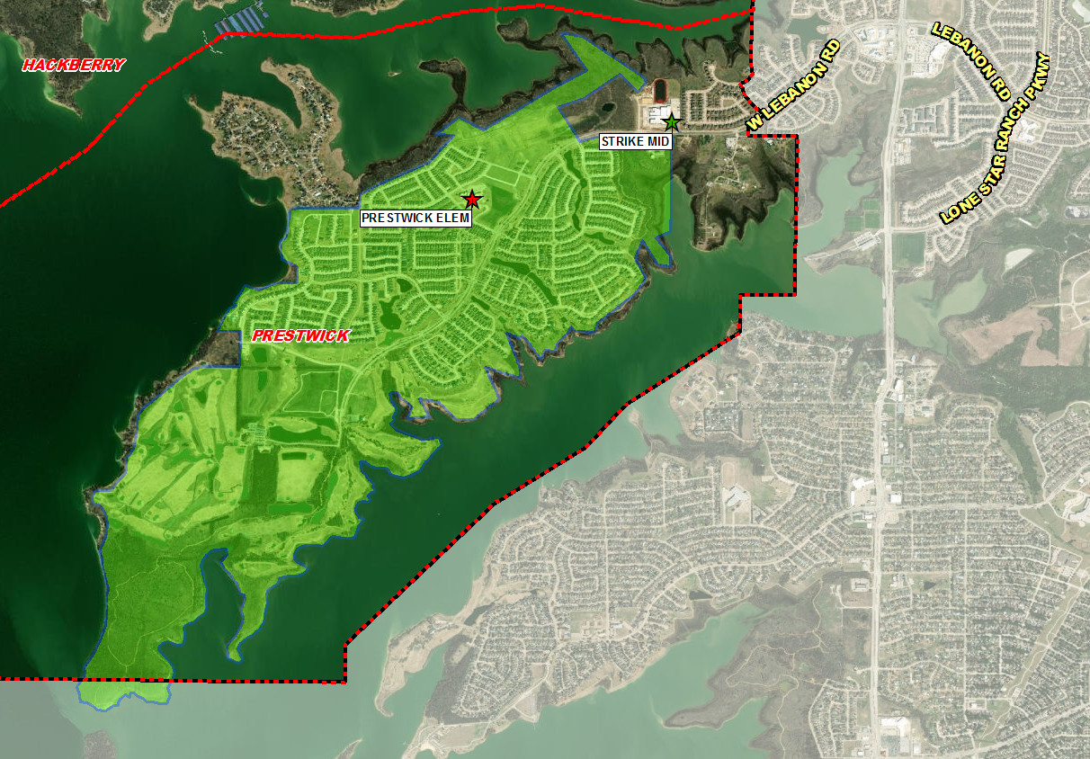
Residential Activity
Tribute
2,446 total lots
258 future lots
172 vacant developed lots
72 homes under construction
1,940 homes occupied
Westbury Ph 6 (92 lots) zoning amendment approved March 2022, groundwork underway
Chelsea Green (166 lots) site plan approved April 2022
Building roughly 120 homes per year
Westbury Ph 6
92 lots
Chelsea Green
166 lots

Slide 11
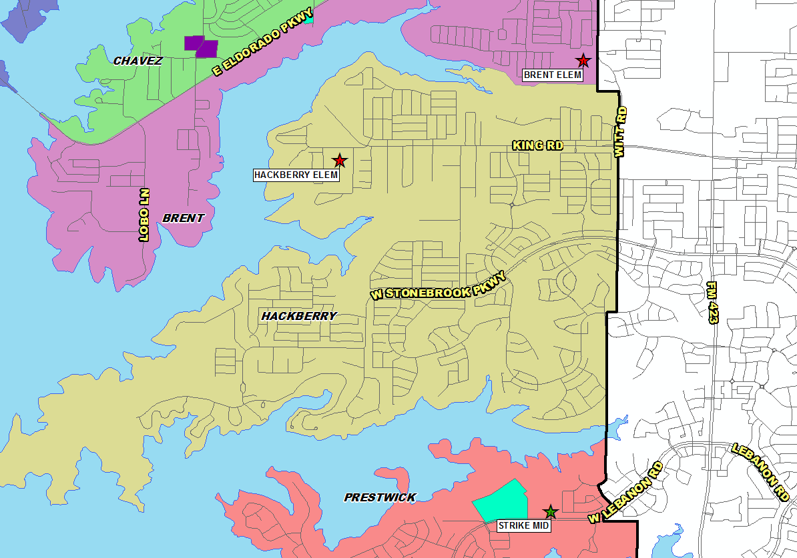
District Multi-Family Overview
There are 324 multi-family units under construction within the distrct
There are an additional 204 future multi-family units in the planning stages, including 159 single-family rental units
Multi-Family Developments
Future Development
Under Construction

Slide 12
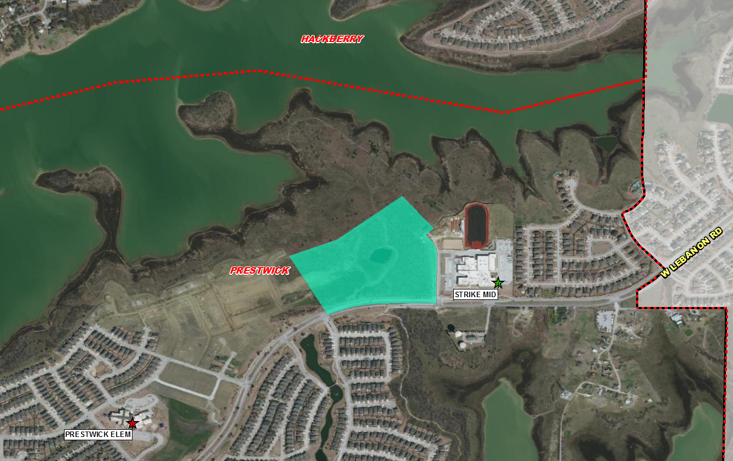
Multi-Family Activity
BB Living at The Tribute
159 future single family rental units
Plans in design phase
No time frame for development at this time

Slide 13
Ten Year Forecast by Grade Level
Year (Oct.) | EE | PK | K | 1st | 2nd | 3rd | 4th | 5th | 6th | 7th | 8th | 9th | 10th | 11th | 12th | Total | Total Growth | % Growth
2017/18 | 33 | 187 | 566 | 563 | 593 | 602 | 609 | 618 | 606 | 542 | 516 | 593 | 519 | 504 | 475 | 7,526
2018/19 | 39 | 179 | 593 | 591 | 576 | 608 | 606 | 634 | 599 | 623 | 575 | 593 | 563 | 529 | 479 | 7,787 | 261 | 3.5%
2019/20 | 45 | 180 | 600 | 623 | 611 | 605 | 620 | 616 | 639 | 629 | 630 | 659 | 570 | 556 | 482 | 8,065 | 278 | 3.6%
2020/21 | 42 | 154 | 579 | 611 | 626 | 588 | 577 | 601 | 622 | 650 | 645 | 687 | 621 | 561 | 544 | 8,108 | 43 | 0.5%
2021/22 | 41 | 152 | 607 | 585 | 624 | 615 | 611 | 581 | 629 | 669 | 678 | 790 | 633 | 554 | 525 | 8,294 | 186 | 2.3%
2022/23 | 41 | 152 | 668 | 674 | 623 | 645 | 647 | 642 | 585 | 655 | 700 | 776 | 743 | 620 | 518 | 8,689 | 395 | 4.8%
2023/24 | 80 | 320 | 702 | 719 | 704 | 639 | 671 | 671 | 635 | 606 | 683 | 802 | 730 | 726 | 580 | 9,268 | 579 | 6.7%
2024/25 | 100 | 350 | 722 | 746 | 730 | 718 | 657 | 690 | 664 | 658 | 631 | 782 | 754 | 716 | 679 | 9,597 | 329 | 3.5%
2025/26 | 100 | 450 | 724 | 768 | 755 | 749 | 734 | 681 | 682 | 681 | 682 | 722 | 736 | 739 | 669 | 9,872 | 275 | 2.9%
2026/27 | 100 | 490 | 733 | 782 | 782 | 778 | 772 | 760 | 685 | 707 | 710 | 781 | 679 | 720 | 691 | 10,170 | 298 | 3.0%
2027/28 | 100 | 490 | 735 | 781 | 794 | 799 | 795 | 800 | 752 | 711 | 729 | 813 | 735 | 665 | 673 | 10,372 | 202 | 2.0%
2028/29 | 100 | 490 | 740 | 786 | 792 | 815 | 816 | 823 | 792 | 763 | 730 | 835 | 765 | 720 | 622 | 10,589 | 217 | 2.1%
2029/30 | 100 | 490 | 762 | 791 | 798 | 811 | 833 | 846 | 816 | 804 | 783 | 836 | 785 | 750 | 673 | 10,878 | 289 | 2.7%
2030/31 | 100 | 490 | 765 | 814 | 803 | 818 | 826 | 865 | 839 | 828 | 825 | 897 | 786 | 769 | 701 | 11,126 | 248 | 2.3%
2031/32 | 100 | 490 | 775 | 817 | 826 | 823 | 835 | 858 | 858 | 852 | 850 | 945 | 844 | 770 | 719 | 11,362 | 236 | 2.1%
Yellow box = largest grade per year
Green box = second largest grade per year

Slide 14
Ten Year Forecast by Campus
 | Maximum | Functional |  | Fall | Projections
Campus | Capacity | Capacity | 2020/21 | 2021/22 | 2022/23 | 2023/24 | 2024/25 | 2025/26 | 2026/27 | 2027/28 | 2028/29 | 2029/30 | 2030/31 | 2031/32
Zellars Early Childhood Center | 600 | 600 | 0 | 0 | 0 | 400 | 450 | 550 | 590 | 590 | 590 | 590 | 590 | 590
Brent Elementary | 914 | 777 | 706 | 702 | 728 | 697 | 691 | 683 | 696 | 713 | 719 | 726 | 730 | 722
Chavez Elementary | 914 | 777 | 543 | 499 | 522 | 489 | 500 | 520 | 534 | 548 | 565 | 575 | 569 | 571
Hackberry Elementary | 914 | 777 | 680 | 711 | 753 | 722 | 747 | 768 | 810 | 816 | 824 | 828 | 834 | 843
Lakeview Elementary | 914 | 777 | 611 | 582 | 622 | 684 | 706 | 727 | 740 | 731 | 731 | 738 | 746 | 763
Oak Point Elementary | 1,070 | 910 | 827 | 856 | 960 | 993 | 1,066 | 1,144 | 1,236 | 1,301 | 1,334 | 1,369 | 1,401 | 1,414
Prestwick Elementary | 834 | 665 | 411 | 466 | 507 | 521 | 553 | 569 | 591 | 595 | 599 | 605 | 611 | 621
ELEMENTARY SCHOOL TOTAL | 4,726 | 4,017 | 3,778 | 3,816 | 4,092 | 4,506 | 4,713 | 4,961 | 5,197 | 5,294 | 5,362 | 5,431 | 5,481 | 5,524
Elementary Absolute Growth |  |  | -122 | 38 | 276 | 414 | 207 | 248 | 236 | 97 | 68 | 69 | 50 | 43
Elementary Percent Growth |  |  | -3.13% | 1.01% | 7.23% | 10.12% | 4.59% | 5.26% | 4.76% | 1.87% | 1.28% | 1.29% | 0.92% | 0.78%
Strike Middle School | 1,200 | 1,020 | 968 | 1,016 | 1,023 | 1,021 | 1,018 | 1,083 | 1,092 | 1,138 | 1,167 | 1,241 | 1,261 | 1,278
Walker Middle School | 1,200 | 1,020 | 949 | 960 | 917 | 903 | 935 | 962 | 1,010 | 1,054 | 1,118 | 1,162 | 1,231 | 1,282
MIDDLE SCHOOL TOTAL |  |  | 1,917 | 1,976 | 1,940 | 1,924 | 1,953 | 2,045 | 2,102 | 2,192 | 2,285 | 2,403 | 2,492 | 2,560
Middle School Absolute Growth |  |  | 20 | 59 | -36 | -16 | 29 | 92 | 57 | 90 | 93 | 118 | 89 | 68
Middle School Percent Growth |  |  | 1.05% | 3.08% | -1.82% | -0.82% | 1.51% | 4.71% | 2.79% | 4.28% | 4.24% | 5.16% | 3.70% | 2.73%
Little Elm High School | 2,500 | 2,125 | 2,413 | 2,502 | 2,657 | 2,838 | 2,931 | 2,866 | 2,871 | 2,886 | 2,942 | 3,044 | 3,153 | 3,278
Denton County JJ AEP |  |  | 0 | 0 | 0 | 0 | 0 | 0 | 0 | 0 | 0 | 0 | 0 | 0
HIGH SCHOOL TOTAL |  |  | 2,413 | 2,502 | 2,657 | 2,838 | 2,931 | 2,866 | 2,871 | 2,886 | 2,942 | 3,044 | 3,153 | 3,278
High School Absolute Growth |  |  | 145 | 89 | 155 | 181 | 93 | -65 | 5 | 15 | 56 | 102 | 109 | 125
High School Percent Growth |  |  | 6.39% | 3.69% | 6.20% | 6.81% | 3.28% | -2.22% | 0.17% | 0.52% | 1.94% | 3.47% | 3.58% | 3.96%
DISTRICT TOTAL |  |  | 8,108 | 8,294 | 8,689 | 9,268 | 9,597 | 9,872 | 10,170 | 10,372 | 10,589 | 10,878 | 11,126 | 11,362
District Absolute Growth |  |  | 43 | 186 | 395 | 579 | 329 | 275 | 298 | 202 | 217 | 289 | 248 | 236
District Percent Growth |  |  | 0.53% | 2.29% | 4.76% | 6.66% | 3.55% | 2.87% | 3.02% | 1.99% | 2.09% | 2.73% | 2.28% | 2.12%
Green = exceeds functional capacity
Yellow = exceeds maximum capacity

Slide 15
Key Takeaways
Texas statewide enrollment rebounded nearly 56,000 students from last year’s decline due to COVID-19
Little Elm ISD continues to see good home sales activity, rising 5% over 2020 totals
Supply chain and labor shortages are impacting the new home activity
The district has 21 actively building subdivisions and 6 future subdivisions
Groundwork is underway on roughly 1,160 lots within 5 subdivisions
LEISD may enroll nearly 10,200 students by 2026/27 and over 11,350 students by 2031/32

